Slide 1
CLASSROOM RULES
Be on time
Be interactive
100% or Nothing
Do all Daily Challenges

Slide 2
REVIEW

Slide 3
1. My father usually goes to work by bus.
/maɪ ˈfɑːðə ˈjuːʒuəli ɡəʊz tuː wɜːk baɪ bʌs./
2. I have my English lessons on Mondays and Thursdays.
/aɪ hæv maɪ ˈɪŋɡlɪʃ ˈlɛsᵊnz ɒn ˈmʌndeɪz ænd ˈθɜːzdeɪz./
3. It takes me about 10 minutes to do the washing up every day.
/ɪt teɪks miː əˈbaʊt 10 ˈmɪnɪts tuː duː ðə ˈwɒʃɪŋ ʌp ˈɛvri deɪ./
4. My brother plays sports with his friends twice a week.
/maɪ ˈbrʌðə pleɪz spɔːts wɪð hɪz frɛndz twaɪs ə wiːk./
5. When she is free, she sometimes plays video games with her younger sister.
/wɛn ʃiː ɪz friː, ʃiː ˈsʌmtaɪmz pleɪz ˈvɪdiəʊ ɡeɪmz wɪð hɜː ˈjʌŋɡə ˈsɪstə./
6. My mom makes dinner for my family every night.
/maɪ mɒm meɪks ˈdɪnə fɔː maɪ ˈfæmᵊli ˈɛvri naɪt./
7. On Saturdays, I clean the house with my brother.
/ɒn ˈsætədeɪz, aɪ kliːn ðə haʊs wɪð maɪ ˈbrʌðə./
8. He goes to the restaurant with his girlfriend once a month.
/hiː ɡəʊz tuː ðə ˈrɛstᵊrɒnt wɪð hɪz ˈɡɜːlfrɛnd wʌns ə mʌnθ./
9. In the summer, I usually go swimming at the swimming pool.
/ɪn ðə ˈsʌmə, aɪ ˈjuːʒuəli ɡəʊ ˈswɪmɪŋ æt ðə ˈswɪmɪŋ puːl./
10. She does exercise every Wednesday morning.
/ʃiː dʌz ˈɛksəsaɪz ˈɛvri ˈwɛnzdeɪ ˈmɔːnɪŋ./

Slide 4
Lesson 6: Nouns
Brought to you by LangGo

Slide 5

2
Common nouns
& proper nouns
OBJECTIVES
4
Singular and plural nouns

Slide 6
1
Common nouns and proper nouns
What are common nouns?
What are proper nouns?

Slide 7
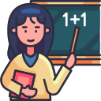


Common nouns are words for people, animals, places, or things.
Teacher
Cat
Office

Slide 8
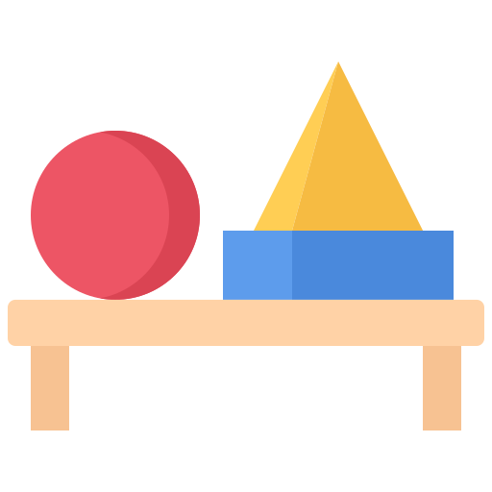



VOCABULARY RACE
JOBS
ANIMALS
PLACES
OBJECTS

Slide 9
Proper nouns are names for particular people, animals, places, or things.
Ms. Jane
Milo
LangGo

Slide 10



VOCABULARY RACE
COUNTRIES
DAYS AND MONTH
FESTIVALS, EVENTS
PLACES

Slide 11
Identify which noun is proper noun, and which noun is common noun by writing P or C:
Ms. Maria is my teacher at the Dong Da School.
My father is a doctor at Bach Mai Hospital.
Jason wants to become an engineer in the future.
The chef at Bella Italia Restaurant makes delicious pasta.
Ms. Lee is the best nurse I have ever met.
My cousin works as a photographer in Paris.
Mr. Brown is a famous singer from Canada.
Emma is training to be a professional dancer.
Dr. Patel opened a new clinic downtown.
P
C
P
C
C
P
P
C
C
P
P
C
C
C
P
P
C
P
P
C
P
C

Slide 12
SINGULAR OR PLURAL NOUNS
2

Slide 13



When you are talking about ONE person, animal, place, or thing, use a singular
A student
An elephant
A house

Slide 14
Phát âm đuôi “s, es”
/s/
vô thanh – vô thanh
parents, works, shorts, books
/z/
hữu thanh – hữu thanh
babies, teachers, doctors, roads
/iz/
buses, roses, dishes, watches, oranges

Slide 15
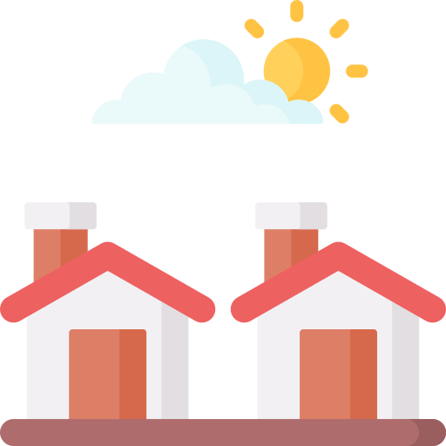


When you are talking about TWO OR MORE people, animals, places, or things, use plural nouns.
Students
Bats
Houses

Slide 16


How to pluralise nouns
A person
People

Slide 17
SINGULAR AND PLURAL FORM
Singular
Ở dạng nguyên thể
A doctor
A road
A hospital
A book
Plural
Thêm “s” vào sau hầu hết danh từ đếm được
Doctor→ doctors
Road → roads
Hospital→ hospitals
Book → books

Slide 18
Note
wolf – wolves
wife – wives
leaf – leaves
life – lives
Note
baby – babies
toy – toys
kidney – kidneys
Vowel + “y” => “ys”
Consonant + ‘y” => “ies”
“f/fe” => “ves”

Slide 19
O, S, SS, CH, X, SH, Z
+ “ES”
bus
watch
boss
dish
quiz
buses
watches
bosses
dishes
quizzes

Slide 20
1 person – 2 people
1 child – 2 children
1 man – 2 men
1 woman – 2 women
1 tooth – 2 teeth
1 foot – 2 feet
1 mouse – 2 mice
1 sheep – 2 sheep
1 deer – 2 deer
IRREGULAR NOUNS

Slide 21
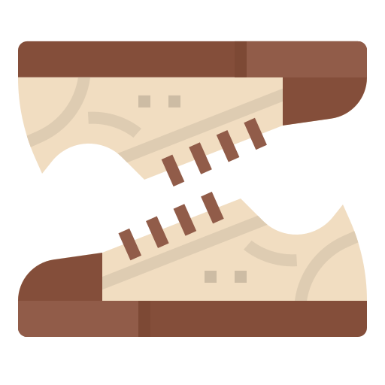
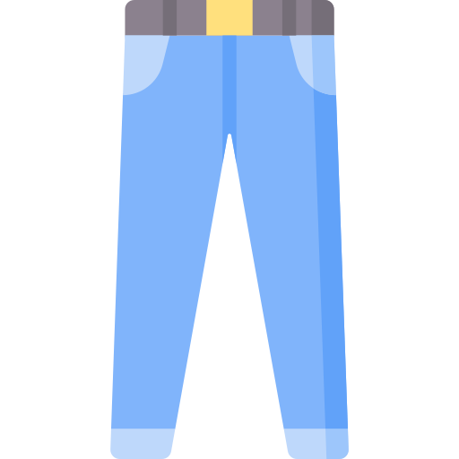


Some nouns are always plural
(A pair of)
Sneakers
Sandals
Shoes
Slippers
Shorts
Pants / Trousers
Stockings
Jeans
Scissors

Slide 22
Choose the correct form of the noun, plural or singular:
parents
Anna: Hello, Tom! What do your ___________ (parent) do ?
Tom: My mother is__________ (nurse) and my father works as ________ (chef). They are both very busy.
Anna: That’s interesting! Where do they work?
Tom: My mother works in ___________(hospital), but my father works in ______________ (restaurant) near my house. He travels to work by _____(bus).
Anna: Wow! I know some ______ (chef). They make great_______ (meal).
Tom: Yes, I want to become_________(chef), just like my father. But I will have to be careful - __________(knife) are sharp, and I can cut myself. How about you? What do you want to do in the future?
Anna: I want to be___________(teacher) when I grow up, because I want to teach_________(child).
Tom: My two ________( aunt) are ___________(teacher), too! But they are kindergarten ________(teacher), so they teach_________(baby).
a nurse
a chef
a hospital
a restaurant
bus
meals
chefs
a chef
knives
a teacher
children
aunts
teachers
teachers
babies

Slide 23
How to talk about jobs:
A: What do your parents do?
B: My mother is a businesswoman, and my father works as a businessman. They are both busy.
A: Are you a student or are you working?
B: I am studying at … high school, and I’m in grade 12.
OR: I’m a first/ second/ third-year student at … university./ I’m in my final year at … university.
a freshman /ˈfreʃ.mən/
a sophomore (UK) /ˈsɒf.ə.mɔːr/, (US) /ˈsɑː.fə.mɔːr/
a junior /ˈdʒuː.ni.ər/
a senior /ˈsiː.ni.ər/
A: What do you want to do in the future?
B: I want to be a teacher when I grow up, because I want to teach children.
A: What is your dream job?
B: My dream is to become a chef, and cook delicious meals for my friends and family.

Slide 24

GOODBYE
SEE YOU LATER!

